Slide 1
A-Density-Based Algorithm for Discovering Clusters
Institute for Computer Science, University of Munich
Oettingenstr. 67, D-80538 Munchen, Germany
{ester|kriegel|sander|xwxu}@informatik.uni-muenchen.de

Slide 2
Target: Class identification in spatial databases
Combination of three requirements:
Minimal requirements of domain knowledge to determine the input parameters.
(Appropriate values are often not known in advance when dealing with large databases. )
Discovery of clusters with arbitrary shape.
Good efficiency on large databases.

Slide 3
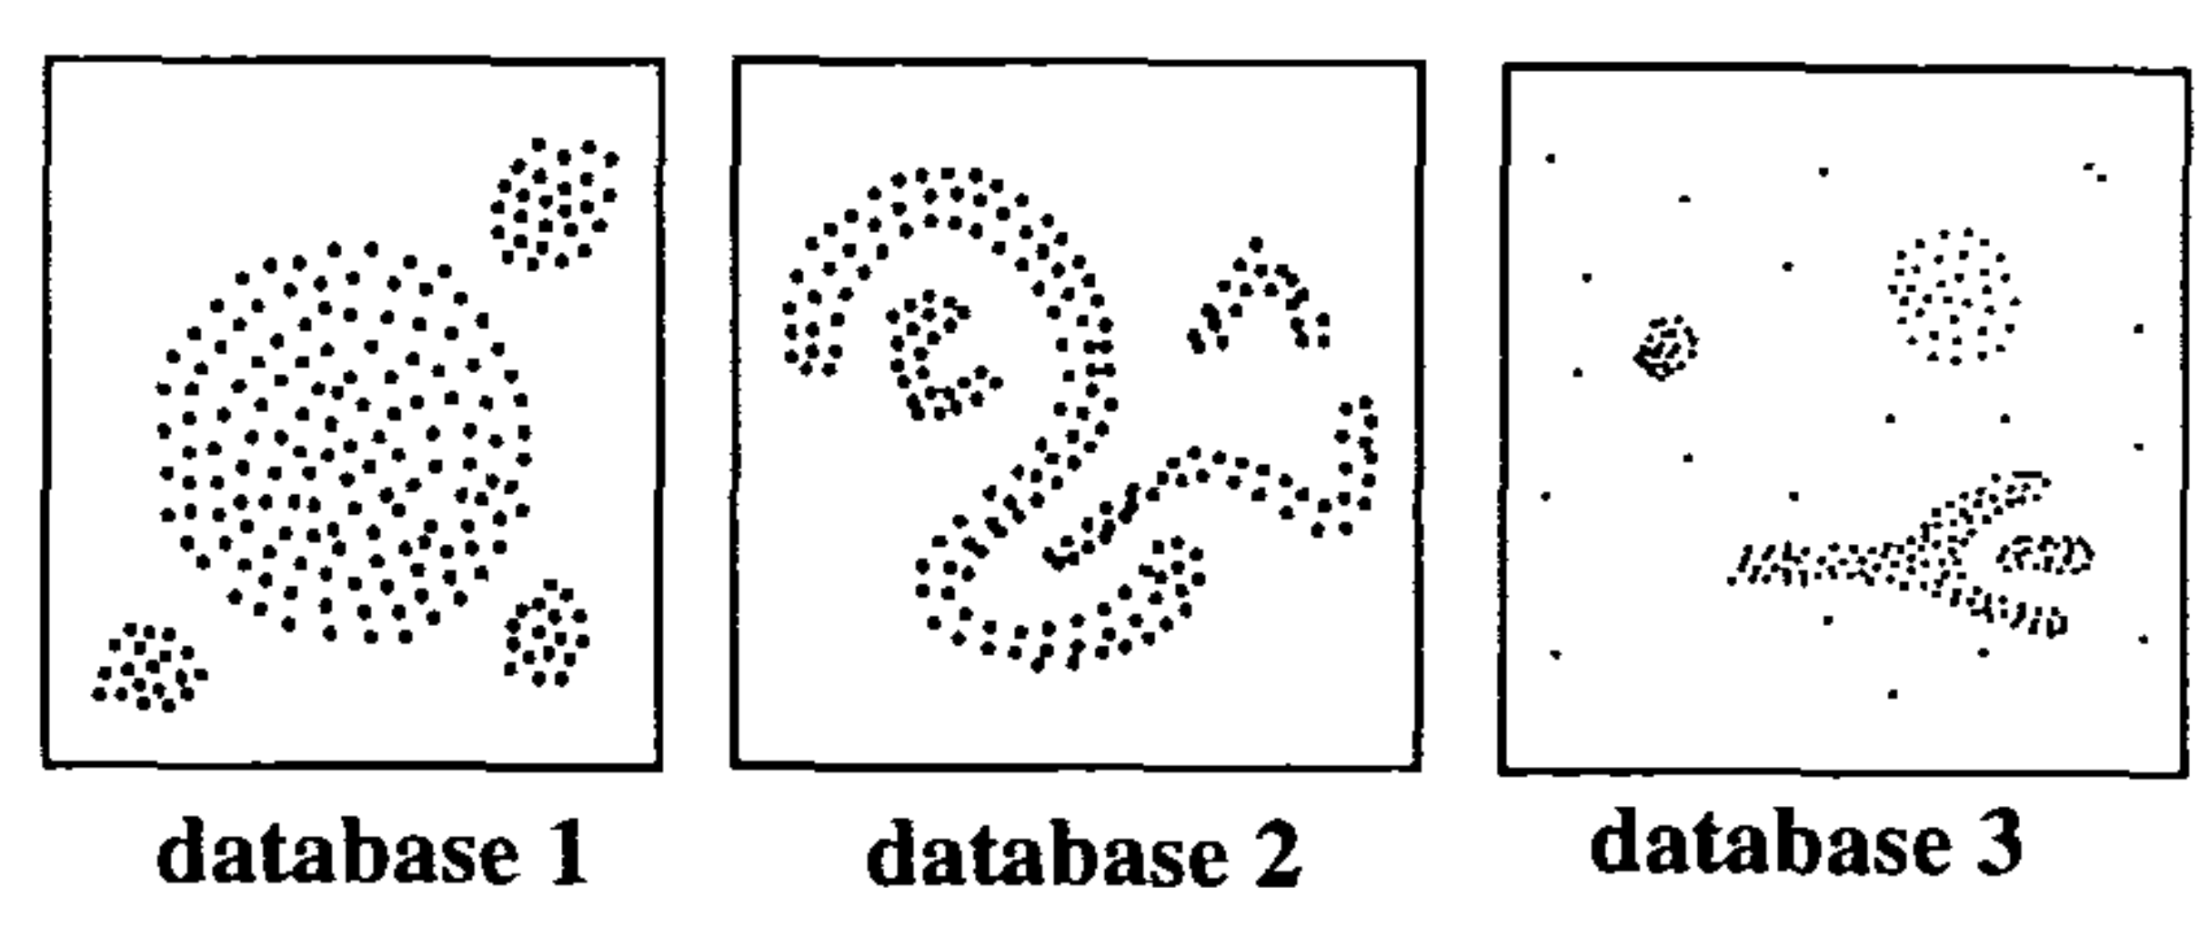
DBSCAN
A Density Based Notion of Clusters:

Slide 4
DBSCAN
Key idea:
  For each point of a cluster the neighborhood of a given radius has to contain at least a minimum number of points, i.e. the density in the neighborhood has to exceed some threshold.
Note: The shape of a neighborhood is determined by the choice of a distance function for two points p and q, denoted by dist(p,q).

Slide 5
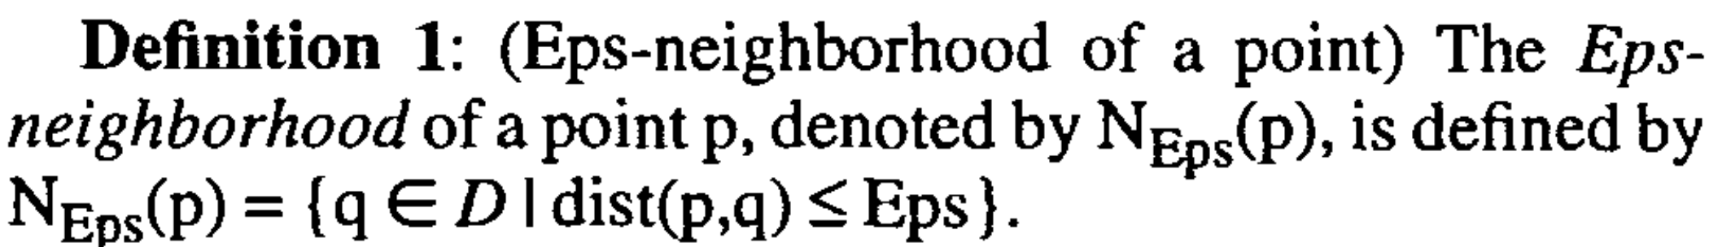
DBSCAN
MinPts: A minimum number of points in an Eps-neighborhood of the point.
Core point:insider of the cluster
Border point: on the border of the cluster

Slide 6
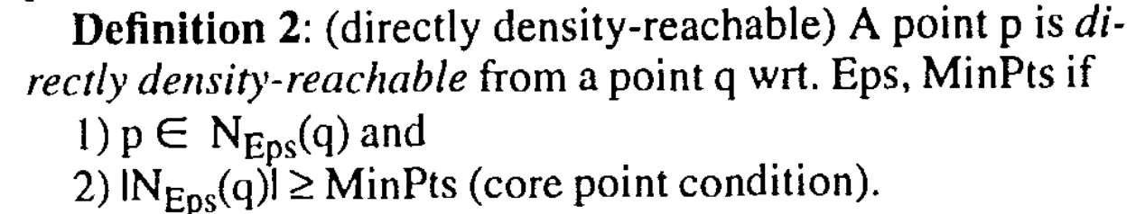
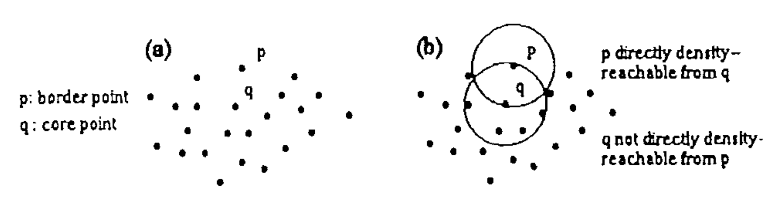
DBSCAN

Slide 7
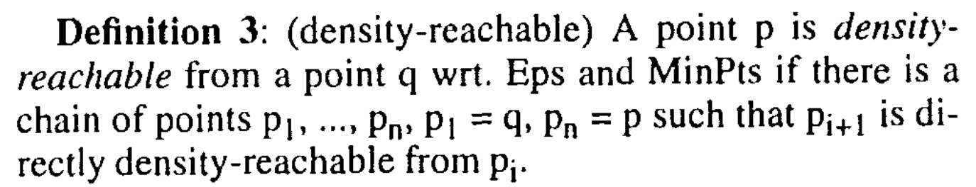
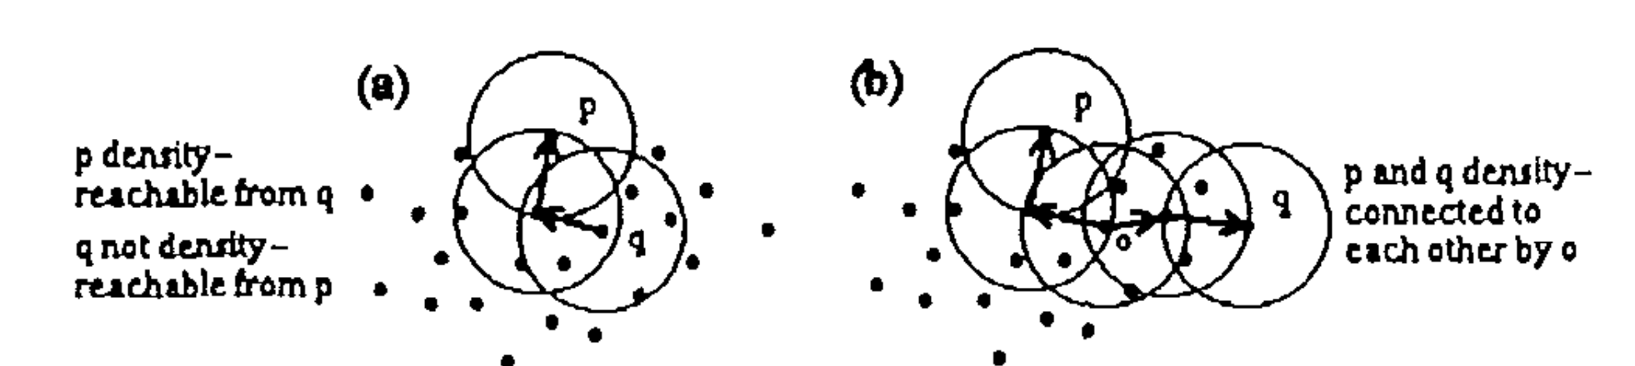
DBSCAN

Slide 8
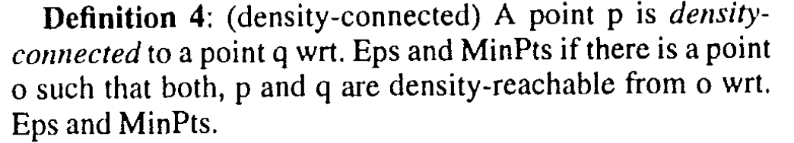
DBSCAN

Slide 9
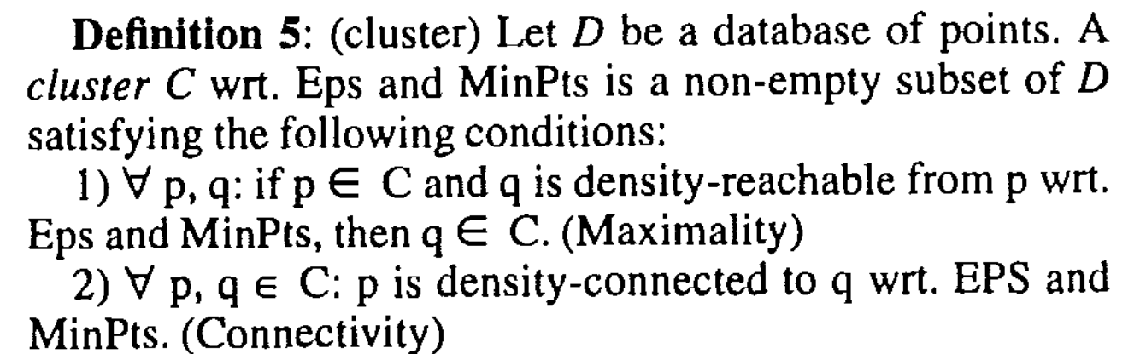
DBSCAN

Slide 10
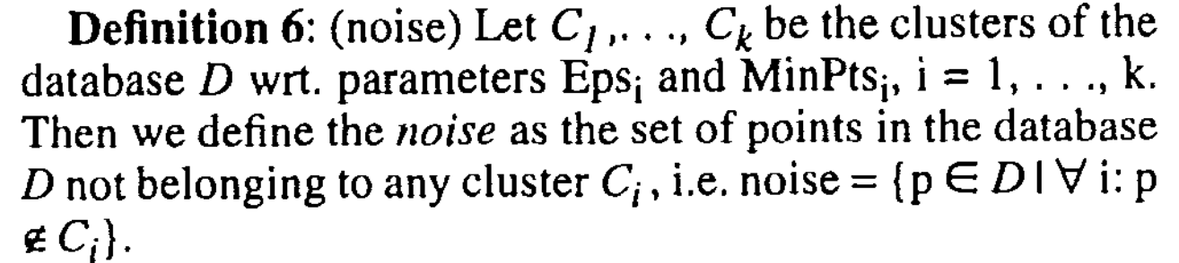
DBSCAN

Slide 11
DBSCAN
Abstract:
1. Choose an arbitrary point from the database satisfying the core point condition as a seed.
2. Retrieve all points that are density-reachable from the seed obtaining the cluster containing the seed.

Slide 12
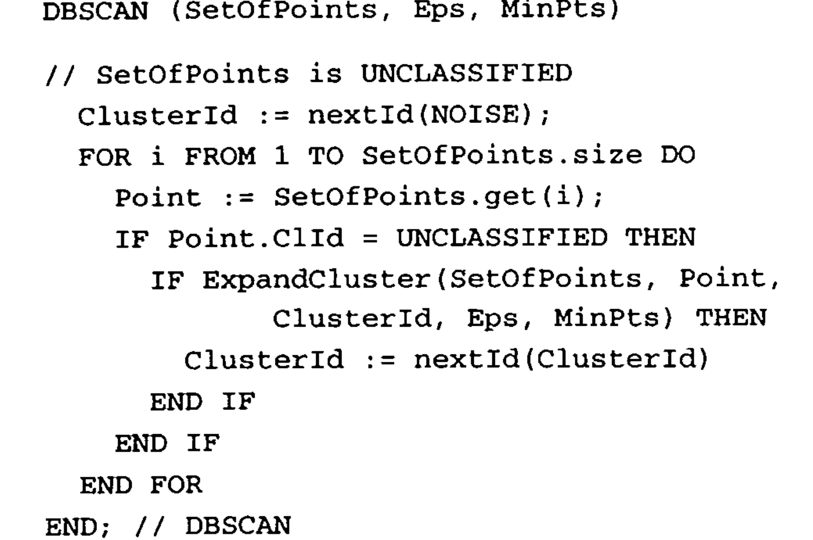
DBSCAN

Slide 13
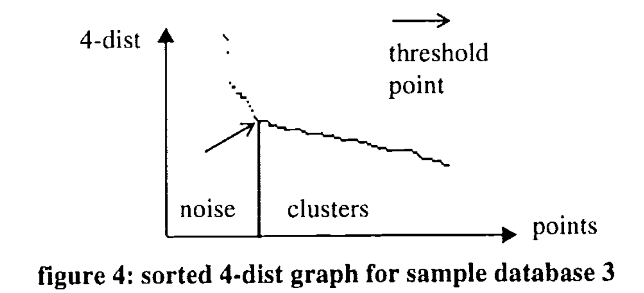
DBSCAN
Determining the Parameters Eps and MinPts

Slide 14
Performance Evaluation
Advantages:
Good efficient and better result (Compared with CLARANS).
Require only one input parameter and supports the user in determining an appropriate value for it.
DisAdvantages:
Only apply on point object.
Need investigated in high dimensional feature spaces.

